Slide 1
Source Code Security Auditing and Vulnerabilities
CIS 4930 / 5930
Offensive Computer Security
Spring 2014

Slide 2
Outline of talk
Intro
CVE
CCE
CWE
Strategy
Common programming errors/bugs
Source code auditing

Slide 3
Software Security Resources
See the:
Common Vulnerablities and Exposures http://cve.mitre.org/
Common Weakness Enumeration http://cwe.mitre.org/
Seven kingdoms of weaknesses Taxonomy http://cwe.mitre.org/documents/sources/SevenPerniciousKingdomsTaxonomyGraphic.pdf
Common Configuration Enumeration http://cce.mitre.org/

Slide 4
National Vulnerability Database
http://nvd.nist.gov/home.cfm
an example: http://web.nvd.nist.gov/view/vuln/detail?vulnId=CVE-2012-0861

Slide 5
CVEs (Common Vulnerabilities and Exposures)
list of information security vulnerabilities that aims to provide common names for publicly known problems
Goal is to make it easier to spread/share data
in house, between divisions, companies, researchers, etc.
across vulnerability databases
Run by MITRE
*should be taught in all software engineering classes....*

Slide 6
CVEs
http://cve.mitre.org
Intended to be a comprehensive list of publicly known vulnerabilities & exposures
vulnerability: "is a mistake in software that can be directly used by a hacker to gain access to a system or network"
exposure: "is a mistake in software that allows access to information or capabilities that can be used be a hacker as a stepping-stone into a system or network"

Slide 7
CCE (Common Configuration Enumeration)
Assigns unique identifiers to configuration guidance statements
example configuration guidance statements:
The required permissions for accessing the directory %System Root%\System32\Setup should be "Administrator Account" only
The "account lockout threshold" for failed password attempts should be 3
For Linux, passwords should be stored in either SHA256 or SHA512, or the default DES formats and in the /etc/shadow file not the /etc/passwd file

Slide 8
CWE
A software weakness is an error that may lead to a software vulnerability, such as those enumerated by the CVE list
Examples software weaknesses include:
buffer overflows, format strings, etc.
structure and validity problems; common special element manipulations
channel and path errors
handler errors

Slide 9
More CWE Examples
user interface errors
pathname traversal and equivalence errors
authentication errors
resource management errors
insufficient verification of data
code evaluation and injection
and randomness and predictability
Weaknesses are a subset of bugs

Slide 10
Code Nomenclature
Code
(Not drawn to any scale, and generally true for any sufficiently large software)
Important Note: Exploits can creatively leverage other things like misconfiguration, weak crypto, etc...
Bugs
Weaknesses
Vulnerabilities
Exposures
Exploited Vulnerabilities

Slide 11
Discovering Vulnerabilities
Three Primary Methods:
Source Code Auditing
Requires source code
Reverse Engineering
Can be done without source code.
Requires binary applications (i.e. not interpreted languages)
very time consuming and requires high technical skill
Fuzzing
Lots of tools / frameworks exist
Easy to make custom ones
Binary or source code availability is unimportant

Slide 12
Source Code Auditing
Tedious and time consuming
Hard to estimate time cost
Requires high knowledge/skill with given language

Slide 13
Source Code Auditing tools
Author’s source code comments
Editors / Reading tools
vi/vim; emacs; source-navigator; notepad++; eclipse; visual studio; Understand; source insight
Pattern matching tools
Static analyzers
prone to missing vulnerabilities
prone to false positives (can waste time)
pen & paper
not obsolete yet

Slide 14
Approaches
Find the most bugs?
Find the easiest to find bugs?
Find the weaknesses that are most reliable to exploit?
It is important to limit the approach
won't ever have enough time to find all the bugs

Slide 15
[My] General Methodology
Understand the Application
features
architecture
programming language
Understand the Attack Surface
inputs
various formats / protocols
code paths
Target your efforts
depends on your style

Slide 16
Understand the Application
Read specs / documentation
Understanding the programming language
Interpreted vs compiled
Features
What features are really complex?
meld of two technologies or media encodings?
Components
Database?
try to hit the Database for SQLi?
File share?
try to upload a file?

Slide 17

Understand the Application
Understand the architecture
Web Service (http daemon)
Web Server
Database
Log in via 3rd party
FIREWALL
Authentication Service
Access Control

Slide 18
Understand the Application
Understand the architecture
Web Service
MMO CLIENT
GAME Server
Database
(admin) MMO CLIENT
FIREWALL
Authentication Service
Access Control
Billing Service

Slide 19

Understand the Application
Understand the architecture
Update Service
Client Application
Master Server
Database
FIREWALL
CD-KEY Validation service

Slide 20
Understanding the Attack Surface
Attacker goals may vary
You must choose which ones to focus on
sabotage?
defacing, attacker deleting records, altering them, destroying user trust
gaining access
to server/service
exploit free service?
of clients machines
attack / harass other users?
botnet?
identity theft?
piracy / theft

Slide 21
Understanding the Attack Surface
Understand inputs / outputs of architecture
dictates targets
Understand inputs of application(s)
dictates attack vectors for exploitation
Prioritize inputs of application that are remotely accessible
update()
sync()
Prioritize authentication mechanisms
weak cookies?
passwords sent in cleartext?
plain encoding?

Slide 22
Understanding the Attack Surface
Remotely accessible code path:
means functions / features that can be executed as a result (or following) network interaction / input
Remotely accessible code paths vs non:
if code path is NOT remotely accessible, not likely to be remotely exploitable
read_config_file()
load_startup_scripts()
initialize()

Slide 23
Targeting:How to think like an attacker
Traditional strategies:
input sources related to code paths
most effective
target important components
Security Mechanisms
Authentication
http/https
Data managment / Database
Interpreters (php)
Complex parsing, protocols, or functions

Slide 24
How to think like an attacker
"Meta Targeting" strategies
Start by looking at source code comments
grep/search for:
FIX THIS, TODO!, XXXX, *******
Swearing / typos
old code
old libraries!
code checked in at 4AM
(its said that SSL was a largely a 4AM decision)
code checked in at same time as other buggy code
or patterns from other buggy code
or code from bad developers

Slide 25
Reading Code
usually frustrating at times
read iteratively
try to understand each component as you read it
gain a glimpse of the big picture
skim past filler code
function prototypes
macros
initial or hardcoded value assignments

Slide 26
Reading Code
Tips from https://www.ibm.com/developerworks/rational/library/11-proven-practices-for-peer-review/
Review fewer than 200-400 lines of code (LOC) at a time
significant diminishing returns above this
Faster code review is not better
Optimal code review is around 300-500 LOC per hour
Never review code for more than 90 mins at a time
significant diminishing returns after this

Slide 27
Reading Code
Be Thorough
vast majority of code is OK
Avoid making assumptions
can cause you to miss bugs, or assume something is done correctly (when it may not be)

Slide 28
Reading Code
Look for abstraction
when used commonly, can be a big source for bugs
Look for when C++ style code and library calls break down into C style code / library calls
usually two developers from different backgrounds => bugs
misuses can lead to vulnerabilities
many devs love abstraction and use it as much as possible
focus on code patterns
copy paste chunks
forgetting to tie up chunk variables i++, j++, k++, i++ ...

Slide 29
Quick review of topics from last time
Integer signedness and promotion
Format strings
Off by one
i++ vs ++i

Slide 30
Integer Signedness / Promotion
if (x > y)
depends on x and y. if one is unsigned, will both be evaluated as unsigned
if (x > 16)
16 is signed by default. So if X is signed and is set to larger than MAX_INT, it will be negative
if (x > 16U)
16 Here is unsigned, so this will be safe due to promotion

Slide 31
Format Strings
printf(input);
unsafe if input has conversion specifiers
printf(“%s”, input);
safe, regardless if input has conversion specifiers
sprintf(tmp, “%s”, input)
printf(tmp)
printf will be unsafe if tmp contains conversion specifiers

Slide 32
Off By One errors
char msg[5]
for (i = 0; i <= 5; i++)
//use msg;
should be < 5
Other example cases
incrementing too many times
improper calculation of bounds
sizeof != strlen

Slide 33
i++ vs ++i
x = i++ - 5;
will set x to i - 5, then increment i afterwards
x = ++i - 5;
will increment i first, then set x accordingly

Slide 34
Programs in memory
When processes are loaded into memory, they are basically broken into many small sections
.text Section
contains the machine instructions (read only)
.data Section
global initialized variables
.bss Section
Heap Section
Stack Section
...

Slide 35
General Bug Causes
bugs in the way the code was implemented
can allow attackers to make the application behave in unintended ways
main causes:
failure to validate input
programmer failure to understand an API
miscalculations
failure to validate results
of operations, functions, etc
application state failures

Slide 36
General Bug Causes
other causes
Complex protocols
Complex file formats
Complex encoding / decoding / expansion
improper Unicode expansion (or other encoding)
Trusting the validity of input
failure to track relationships, object references, etc
look for where object-oriented-style, string-aware C++ code suddenly breaks down into C standard library calls.

Slide 37
Safe functions / API's
Despite the existence of safe functions and safe APIs
Developers still misuse them or completely misunderstand them
improper calculation
of API inputs, of string size (forgot the NULL terminator)
improper parameters
the length variable can be completely misunderstood
etc..

Slide 38
Focusing on bugs that lead to vulnerabilities
less rambling, more usefulness

Slide 39
General Bug Categories -> vulns
Not complete list:
API Based Bugs
Programming Construct Errors
State Mechanics
External Resource Interactions
metacharacter injection
From: http://www.blackhat.com/presentations/bh-europe-06/bh-eu-06-Wheeler-up.pdf

Slide 40
General Bug Cases
Not complete list:
API Based Bugs
misuse of API’s provided by OS, language, or application
dangerous use of sprintf(), srncpy(), strncat(), printf(), syslog()...
overly complex APIs lead to dev errors

Slide 41
General Bug Cases
Not complete list:
Programming Construct Errors
bad programming constructs
integer signedness
integer boundaries
logically wrong checks
bad boundary checks
using uninitialized vars / unchecked vars

Slide 42
General Bug Cases
Not complete list:
State Mechanics
Bugs where process left in inconsistent state
thread safety issues
global variables
locks / deadlocks
privileges

Slide 43
General Bug Cases
Not complete list:
External Resource Interactions
bugs where various components interact dangerously
SQLi ‘ “ ; --
XSS < >
directory traversal .. / .. /
special files (/dev/, LPT0, …)

Slide 44
Metacharacter injection
Different languages / interpreters have different metacharacters
Often applications interface with other components
Sometimes these components are
shells
libraries / code in other languages
databases
Important to note how each component handles metacharacters, and how bugs can be introduced

Slide 45
Metacharacter injection
Important cases
comment symbols
-- in SQL
union, or metacharacters that extend commands
&&, AND, ;
wildcard symbols
*, %
String closure/start
' "

Slide 46
Integer overflow
source: pentest.cryptocity.net
int checkSize(unsigned int inputLength)
{
unsigned short length;
length = inputLength;
if (length >= 128)
return 1;
return 0;
}

Slide 47
Integer overflow pt2
source: pentest.cryptocity.net
#define MAXSOCKBUF 4096
int readSocketData(int sock){
char buf[MAXSOCKBUF];
int length;
read(sock, (char *)&length, 4);
if (length < MAXSOCKBUF)
read(sock,buf,length);
//.....
}
//Comparison between two signed values
If length is 0xFFFFFFFF it will be -1 !
Send it a big packet and it will crash! ( likely exploitable!)

Slide 48
Integer overflow pt2
source: pentest.cryptocity.net
#define MAXSOCKBUF 4096
int readSocketData(int sock){
char buf[MAXSOCKBUF];
int length;
read(sock, (char *)&length, 4);
if (length < MAXSOCKBUF)
read(sock,buf,length);
//.....
}
//Comparison between two signed values
So will read() still work? It only takes in unsigned ints for size parameter

Slide 49
Integer bug CVE-2001-0144
source: http://users.ece.cmu.edu/~dbrumley/pubs/integer-ndss-07.pdf
int detect_attack(u_char *buf, u_char *IV){
static word16 *h = (word16 *) NULL;
static word16 n = HASH_MIN_ENTRIES;
register word32 i, j;
word32 l;
...
for (l=n; l<HASH_FACTOR(len/BSIZE); l=l<<2);
if (h == NULL) { debug("Install crc attack detector");
n = l;
h = (word16 *)xmalloc(n*sizeof(word16));
} //...
for (c=buf, j=0; c < (buf+len); c+=BSIZE, j++){
for(i=HASH(c) & (n-1); h[i] != UNUSED; i = (i+1) & (n - 1) .....
h[i] = j;
}
}
Can you spot it?

Slide 50
Integer bug CVE-2001-0144
source: http://users.ece.cmu.edu/~dbrumley/pubs/integer-ndss-07.pdf
int detect_attack(u_char *buf, u_char *IV){
static word16 *h = (word16 *) NULL;
static word16 n = HASH_MIN_ENTRIES;
register word32 i, j;
word32 l;
...
for (l=n; l<HASH_FACTOR(len/BSIZE); l=l<<2);
if (h == NULL) { debug("Install crc attack detector");
n = l;
h = (word16 *)xmalloc(n*sizeof(word16));
} //...
for (c=buf, j=0; c < (buf+len); c+=BSIZE, j++){
for(i=HASH(c) & (n-1); h[i] != UNUSED; i = (i+1) & (n - 1) )
h[i] = j;
}
}
See: http://web.nvd.nist.gov/view/vuln/detail?vulnId=CVE-2001-0144
integer Truncation
Exploitable code that leads to memory corruption

Slide 51
Buffer overflow
int some_function(char *inputstring)
{
char buf[256];
/* make a temp copy of data to work on */
strcpy(buf, inputstring);
.....
return;
}

Slide 52
Buffer overflow pt2
int maybe_safer_function(char *inputstring)
{
char buf[256];
/* make a temp copy of data to work on */
strncpy(buf, inputstring, strlen(inputstring));
.....
return;
}

Slide 53
Buffer overflow pt3
int maybe_safer_function(char *inputstring, char * inputstring2)
{
char buf[256];
strncat(buf, inputstring, strlen(buf)); strncat(buf, inputstring2, strlen(buf));
.....
return;
}

Slide 54
Now without hints

Slide 55
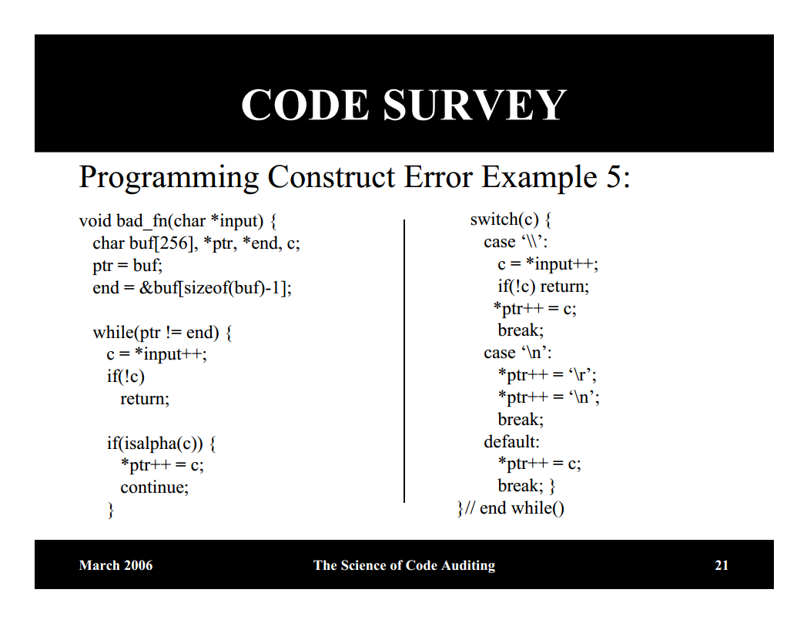
from http://www.blackhat.com/presentations/bh-europe-06/bh-eu-06-Wheeler-up.pdf
Notes:
note: \n

Slide 56
Example 2 (no hints, 3 vulns)
(from Jared DeMott. “Source Code Auditing”. Black Hat 2008.)
#include <syslog.h>
#include <stdio.h>
#include <stdlib.h>
#include <string.h>
#define BUFLEN 16
int main(int argc, char *argv[]) {
char buf1[16];
char buf2[16];
char buf3[BUFLEN];
int i, len;
if (argc != 12){
exit(0);
}
strncpy(buf1, argv[1], sizeof(buf1));
len = atoi(argv[2]);
if (len < 16){
memcpy(buf2, argv[3], len);
} else
{
strcpy(buf2, "UNINITIALIZED");
char *buf = malloc(len + 20);
if (buf) {
snprintf(buf, len+20,
"String too long: %s", argv[3]);
syslog(LOG_ERR, buf);
}
}
// . . .
}

Slide 57
Example 2.1 (no hints, 2 vulns)
(from Jared DeMott. “Source Code Auditing”. Black Hat 2008.)
#include <syslog.h>
#include <stdio.h>
#include <stdlib.h>
#include <string.h>
int main(int argc, char *argv[]) {
char buf3[BUFLEN];
int i, len;
char *buf4;
char *buf5;
char *buf6[16];
if (argc != 12)
exit(0);
// . . .
strncpy(buf3,argv[4], sizeof(buf3)-1);
strncat(buf3, argv[5],sizeof(buf3)-1);
if (fork()){
execl(“/bin/ls”, “/bin/ls”, argv[6], 0);
}
char *p; //filter out metacharacters
if (p =strchr(argv[7], ‘&’))
*p = 0;
if (p =strchr(argv[7], ‘`’))
*p = 0;
if (p =strchr(argv[7], ‘;’))
*p = 0;
if (p =strchr(argv[7], ‘|’))
*p = 0;
if (strlen(argv[7] > 1024){
buf4 = malloc(20+strlen(argv[7]));
sprintf(buf4, “/bin/cat %s”, argv[7]);
system(buf4);
Notes:
strncat,

Slide 58
Concluding Remarks
Not Comprehensive coverage of bugs / types
Best I expect you to understand without heavy C experience

Slide 59
Questions?

